Slide 1
Taproot

Slide 2
Taproot update (Nov ~16th)
Update includes:
Schnorr Signatures for secp256k1 (BIP 340): Will replace ECDSA
Taproot (BIP 341): SegWit version 1 spending rules
Tapscript (BIP 342): Validation of Taproot Scripts
Other key feature: MAST (Merklized Abstract Syntax Trees)

Slide 3
Schnorr Signatures (BIP 340)
More privacy due to sender anonymity
Schnorr signatures are smaller than Bitcoin signatures and keys leading to smaller TX size
Allows n-of-n multisignatures which, from a verifier's perspective, are no different from ordinary signatures, giving improved privacy and efficiency versus CHECKMULTISIG or other means.
Other protocols make it possible to realize k-of-n threshold signatures, which ensure that any subset of size k of the set of n signers can sign but no subset of size less than k can produce a valid Schnorr signature. However, the practicality of the existing schemes is limited: most schemes in the literature have been proven secure only for the case k-1 < n/2, are not secure when used concurrently in multiple sessions, or require a reliable broadcast mechanism to be secure.

Slide 4
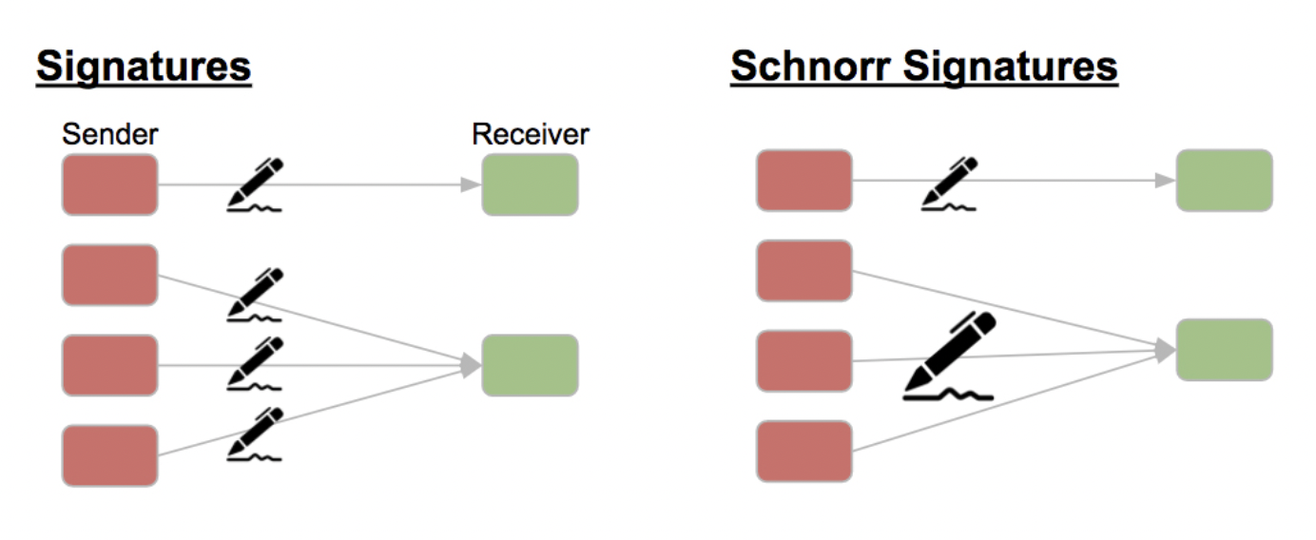
Schnorr Signatures (BIP 340)
It becomes impossible to say if the sender is one person or several

Slide 5
Schnorr Signatures – How it works
Generator G and point on curve is Y = x ⋅ G where x private key and Y public key
Choose k randomly 0 < k < p (p is equal to 𝑛 of ECDSA)
R := k ⋅ G
e := H(R_{x} ∥ 𝑚) where m is the message
s := (k + x e) mod q if the bit length of e is greater than the bit length of q is, before the calculation of s, the surplus (right) bits of e are deleted.
(e, s) or (R, s) are signature of 𝑚
ECDSA comparison:
Choose random 𝑘, 1 ≤ 𝑘 ≤ 𝑛−1
R := 𝑘 ⋅ 𝐺 [ R_{x} = (𝑘 ⋅ 𝐺 )_{x} mod 𝑛 ]
𝑒 = H(𝑚)
𝑧 = 𝐿_𝑛 leftmost bits of 𝑒
𝑠 := 𝑘^(−1) (𝑧 + 𝑟 x) mod 𝑛
(𝑟,𝑠) or (𝑟,−𝑠 mod 𝑛) are signature of 𝑚

Slide 6
Schnorr Signatures – Verify
Verify (e, s):
Calculate R := (s ⋅ G) – (e ⋅ Y)
Calculate e_{v} = H(R_{x} ∥ 𝑚)
Verify (R, s):
s ⋅ G = R + H(R_{x} ∥ 𝑚) ⋅ Y

Slide 7
Schnorr Signatures - Linearity
Analogy:
Adding y₁=a₁*X + b₁ , y₂=a₂*X + b₂
The result is another line equation y₃= y₁+y₂= (a₁+a₂)* X + (b₁+b₂), where the new slope a₃= (a₁ + a₂) and the new y-intercept is b₃ = (b₁+b₂)
Private keys x_{i} and public keys y_{i}
s := (k + x₁ ⋅ e + x₂ ⋅ e + ... )
r := (s ⋅ G) – (e ⋅ y₁) – (e ⋅ y₂) – ... (?)
If (r,s) is used:
s := (s₁ + s₂ + ... )
r := (r₁ ⋅ r₂ ⋅ ... )
y := (y₁ ⋅ y₂ ⋅ ... )
Solution: Bellare-Neven

Slide 8
Schnorr Signatures - Bellare-Neven & MuSig
Problem:
You should not trust y as a signature, because it is not recognizable whether it is the sum of the public keys or only the public key of one party.
Solution:
Bellare-Neven: Requires the Publik key of all participants
MuSig: Will be used in Bitcoin and achieves 25% space reduction on blockchain
TBD

Slide 9
Taproot
 | Current TX | Commitment TX
 | Input (e.g. lightning channel funding TX)
 | A ⬜ B ✓ |  |  | 1 BTC
 | Output
 | P2PKH B_{pubkey} 📅 locktime | P2SH A_{pubkey} B_{pubkey} |  | 1 BTC
 | Taproot TX | Commitment TX
 | Input (e.g. lightning channel funding TX)
 | A ⬜ B ✓ |  |  | 1 BTC
 | Output
 | P2TR P_{pubkey} |  |  | 1 BTC
2-of-2 aggregate key: C_{pubkey} = A_{pubkey} + B_{pubkey}
timelock script: S = "<timeout> OP_CSV OP_DROP B OP_CHECKSIGVERIFY”
New key which is published: P = C + H(C||S) G

Slide 10
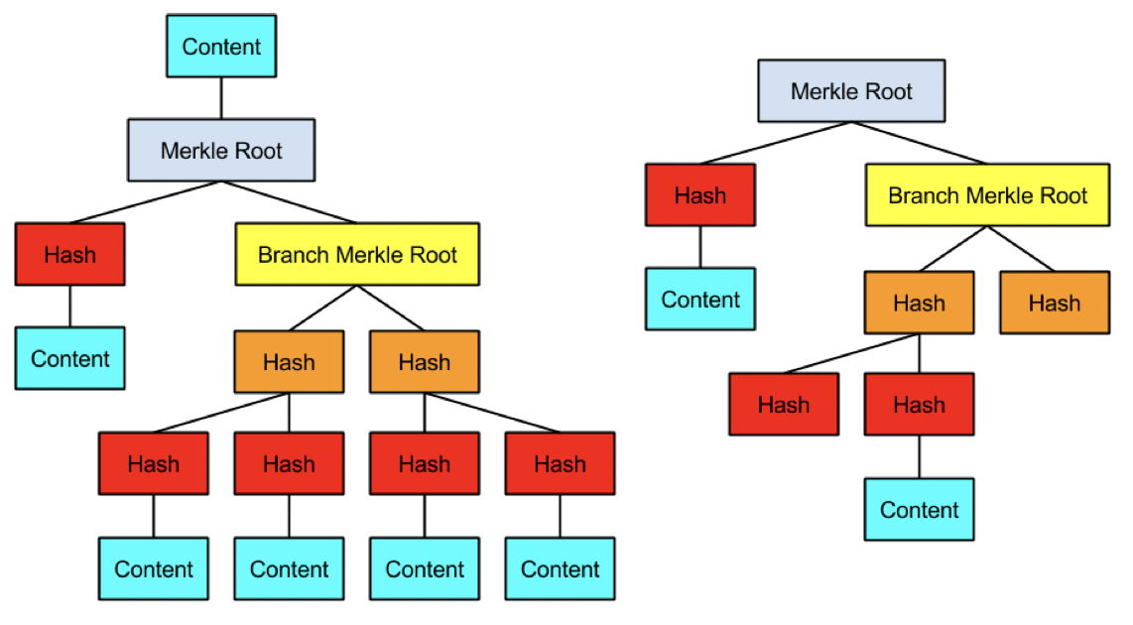
Taproot: MAST (Merklized Abstract Syntax Trees)
Taproot resembles MAST and always includes a condition where all participants can cooperate to spend the funds: the “cooperative close.”

Slide 11
Sources
https://bitcoin.stackexchange.com/questions/96025/what-are-some-interesting-applications-of-taproot-smart-contracts
https://bitcoinmagazine.com/technical/taproot-coming-what-it-and-how-it-will-benefit-bitcoin
https://tara-annison.medium.com/what-are-taproot-mast-and-schnorr-signatures-b737dae20681
https://rubin.io/public/pdfs/858report.pdf
https://lists.linuxfoundation.org/pipermail/bitcoin-dev/2018-January/015614.html

Slide 12
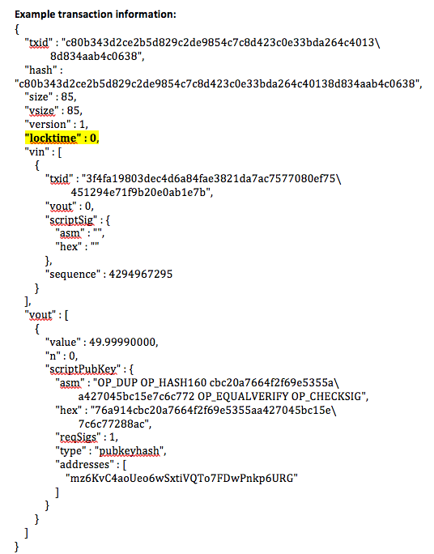
MAST (Merklized Abstract Syntax Trees)
Example: Combined locktime contract
Bob can spend the 10 BTC only if he waits 7 days
If he wants to spend them before 7 days elapse, he can only access 4 BTC and the remaining 6 should be returned to Alice at a specified address.
Bob can access the 10 BTC before 7 days but only if Charlie also signs the transaction.

Slide 13
MAST
MAST (Merkelized Abstract Syntax Tree) is a proposed solution that uses Merkle trees (a decades-old, compact data structure invented by cryptographer Ralph Merkle) to work around these two downsides. In short, all the different conditions under which the funds can be spent are individually hashed (as opposed to combined into a single hash) and included in a Merkle tree, which ultimately produces a single hash: the Merkle root. This Merkle root “locks up” the coins.
Yet with Schnorr, Taproot can do even better: a transaction can hide that a MAST-structure existed at all.

